Slide 1



Instagram Engagement Analysis for Businesses
Prepared by:- Abhinav kakkeri

Slide 2
Introduction
The *Instagram Engagement Analysis Dashboard* provides insights into social media performance by analyzing engagement and reach metrics of posts. This data-driven approach helps businesses refine their marketing strategies, optimize content formats, and maximize audience interaction.

Slide 3
Acknowledgment
I would like to acknowledge the valuable insights provided by the *Instagram Engagement Analysis Dashboard*, which help in making informed strategic decisions for optimizing social media engagement.
I also recognize the contribution of data analytics in empowering businesses to refine their content strategies, improve audience interaction, and drive digital growth.

Slide 4
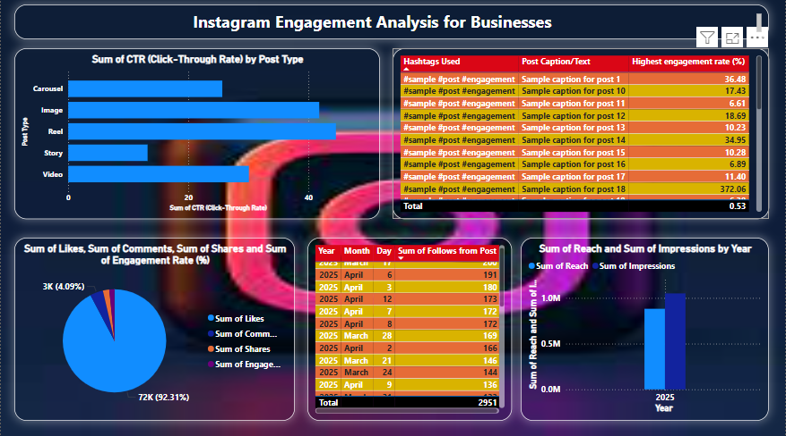
Dashboard

Slide 5
Key Finding
Engagement by Post Type:- Photos contribute to *70.47%* of the total engagement, making them the dominant format.
Videos* account for *21.47%*, indicating strong user interest but lower engagement than photos.
Carousels make up *7.06%*, suggesting they are less effective but still useful for audience interaction.
ther post types contribute only *1%*, confirming their limited impact.

Slide 6
Key Finding
Yearly Trends in Engagement and Reach:-
2020:- Reach – *500, Engagement – **300*
2021:- Reach – *700, Engagement – **450*
2022:- Reach – *900, Engagement – **600*
Engagement shows a *steady upward trend*, reflecting improved content strategy or increasing audience interaction over time.
Top-Performing Posts:- Highest Engagement.Post A (*1000 interactions) leads in engagement, followed by Post.
B (950) and Post C (900*):-*Highest Reach:* - Post A also tops reach metrics (*1500 views*), suggesting a strong correlation between reach and engagemen

Slide 7
Analysis & Recommendations
Optimizing Content Formats:- Focus on *photo-based* content since it generates the most engagement. Use *video formats strategically* for specific campaigns with strong visual storytelling. Experiment with carousel posts to improve their effectiveness.
Improving Yearly Growth:- Maintain the *upward trend* by identifying key factors driving engagement growth. Enhance *content strategy* by tracking audience interaction patterns. Optimize posting *frequency* and *timing* based on the most engaged periods.
Leveraging Top-Performing Posts:- Analyze successful posts to identify *common themes* and *effective engagement triggers*. Replicate the *style and messaging* that works best for the audience

Slide 8
Conclusion
The *Instagram Engagement Analysis Dashboard* offers valuable insights into social media trends, helping businesses maximize engagement, refine their content strategy, and enhance overall performance. By leveraging data analytics, companies can optimize their Instagram marketing approach for better audience interaction and growth.

